Slide 1
Understanding Olympic Medal Success: A Country-Level Data Science Approach
Predicting Olympic Medal Success: A Country-Level Data Science Approach
Group A
Maxim Lisiansky, Noam Ben Moshe, Roy Kremer, Romi Richter, Avraham Elbaz

Slide 2


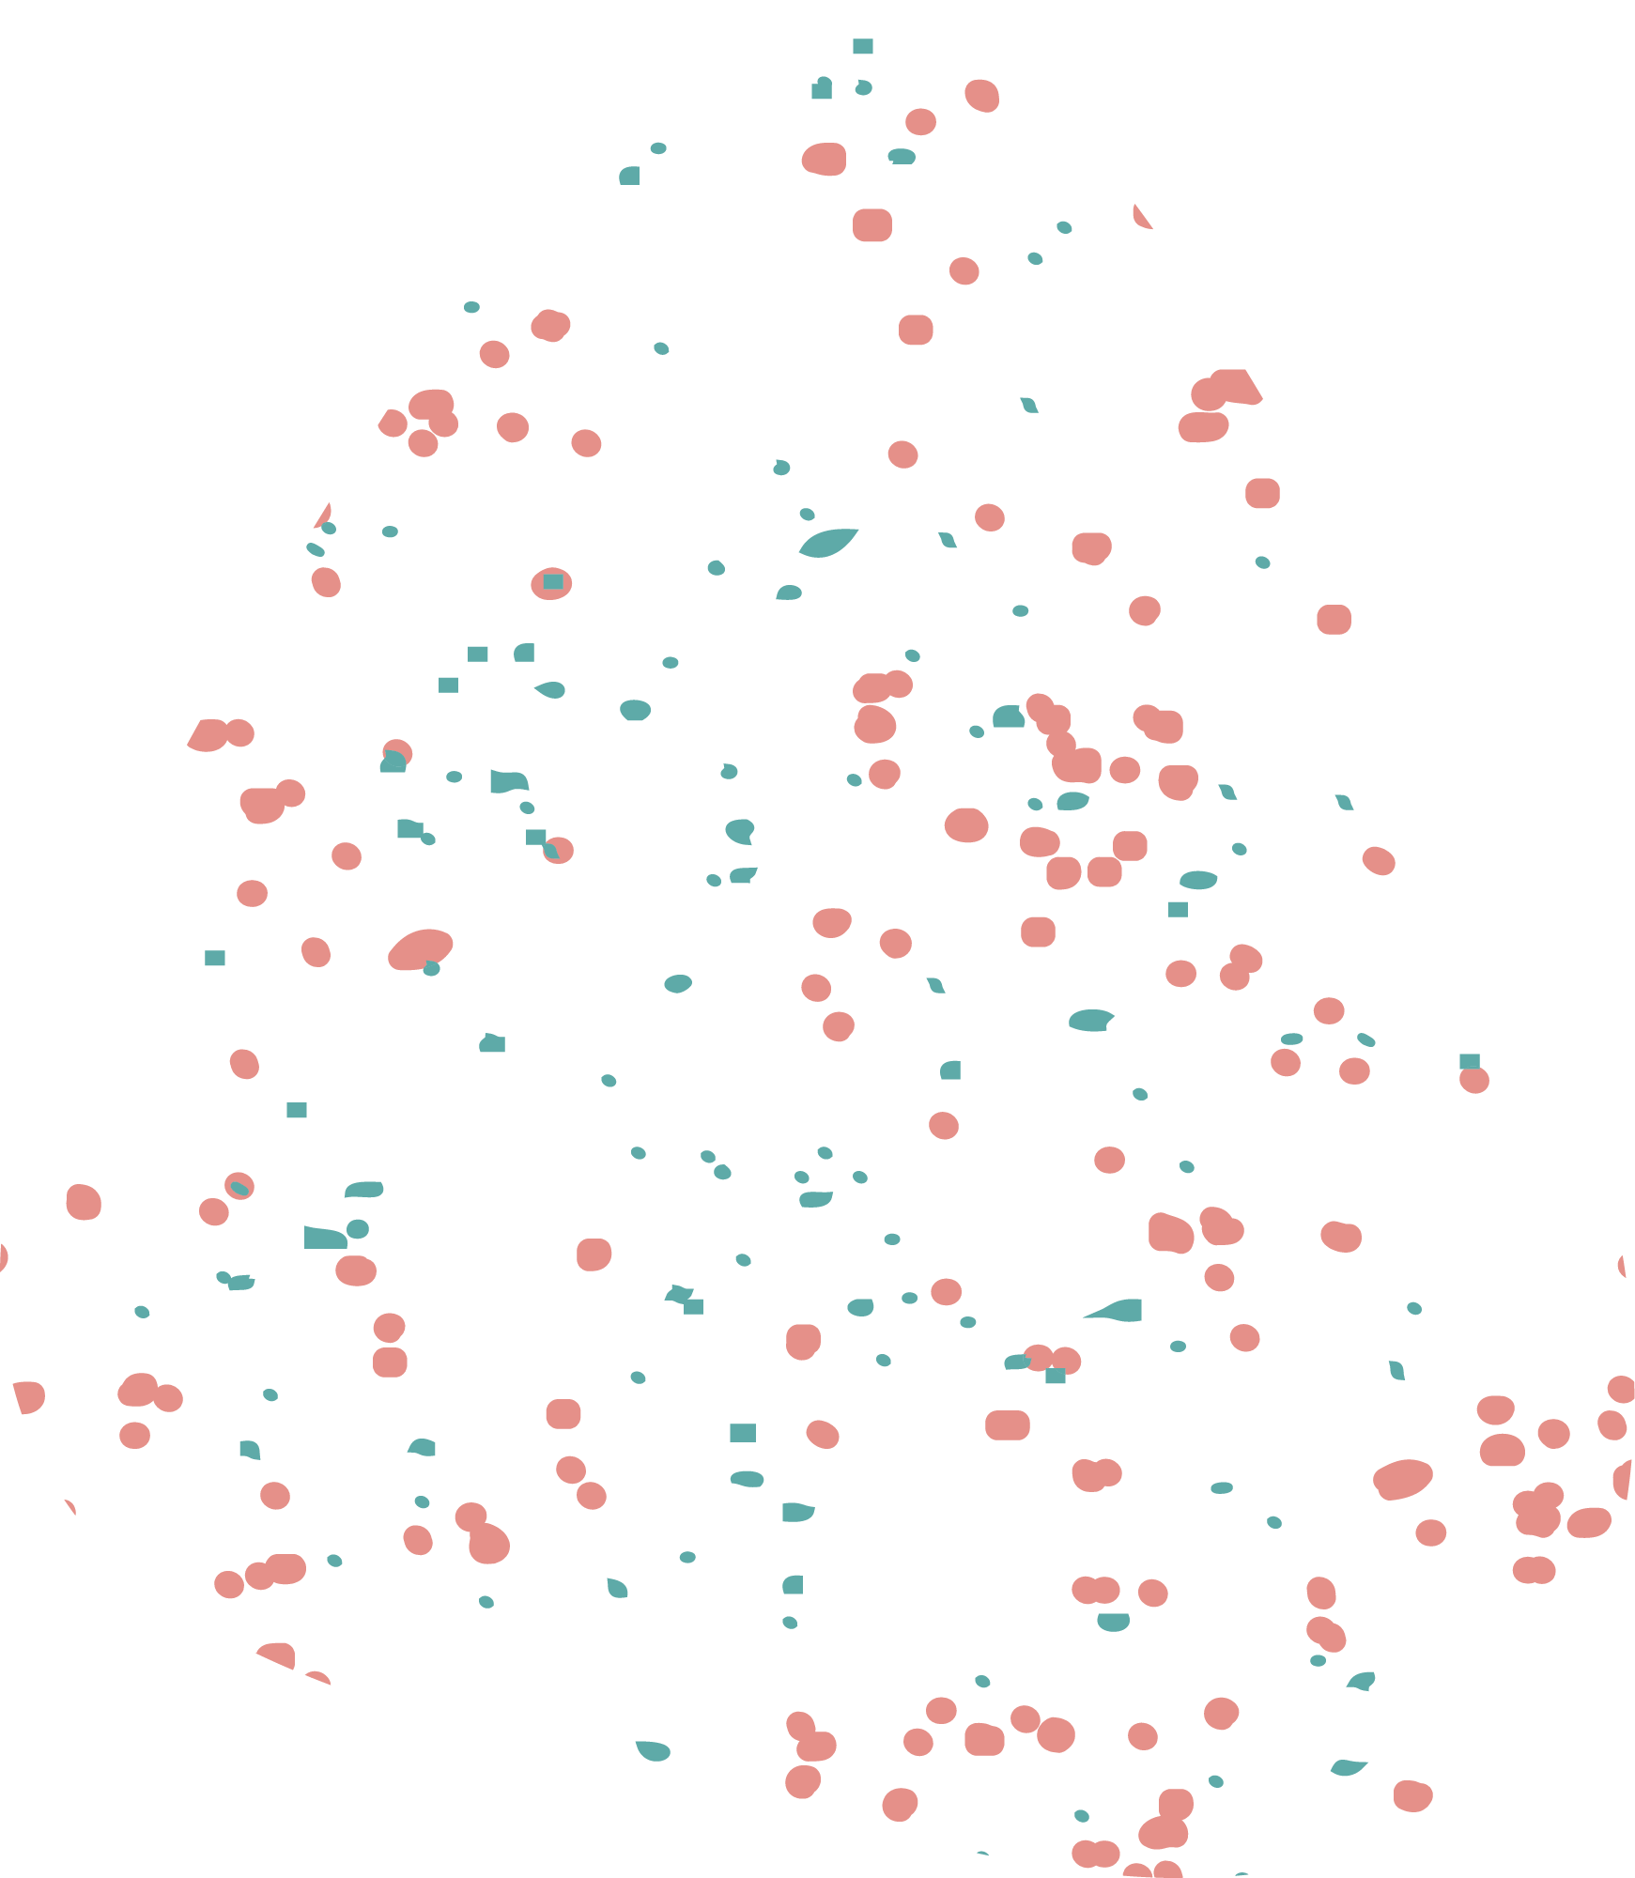
Which country-level factors are most important in predicting Olympic medal counts?

Slide 3
Motivation:
Latest Work
New data
New Models
More wide approach
Latest work found is from 2014 ish
The data explored spans over more than 4 decades
New models and approaches of recent years
Including a wide range of models,data an analysis

Slide 4
Related Work:
01
02
03
Article 1
Article 2
Article 3
04
05
Article 4
Article 5
Predicting Olympic Medal Counts: the Effects of Economic Development on Olympic
The (Non) Determinants of Olympic Success
Who Wins the Olympic Games: Economic Resources and Medal Totals
Team Payroll Versus Performance in Professional Sports: Is Increased Spending Associated with Greater Success?"
Olympic Success and ASEAN Countries: Economic Analysis and Policy Implications

Slide 5


Our Data
Add here something if needed idk

Slide 6
Data sets
CountriesGDP 1960-2020
olympic_hosts
63 entries
11 columns
Features:
Type ,GamesUrl,Disciplines .DisciplinesList,Country,Date ,Athletes,Countries ,Events ,City,Year
20 Missing Values
120 entries
63 columns
Features:
Contry Name, Country Code, Years 1960 through 2020
1 Missing values
01
02
03
04
05
athlete_events
Regime_df
API_SP.POP.TOTL_DS2_en_csv_v2_131993
69793 entries
15 columns
Features:
ID,Name,Sex,Age,Height,Weight,Team,NOC,Games,Year,Season,City,Sport,Event,Medal
68,534 Missing values
A newly created df using Wikipedia which states the countries that were under a communist regime.
Features:
Country.Country_Code,Year,Regime
266 entries
70 columns
Features:
Contry Name, Country Code, Indicator Name, Indicator Code, Years 1960-2024
266 Missing values

Slide 7

Data Preprocessing Steps
Standardized country names across all datasets (lowercase, no spaces, consistent codes) to ensure successful joins.
Resolved issues with alternative country names and changes over time (e.g., “USA” vs. “United States”).
Removed all rows where either GDP or population was missing for a given country-year.
Specifically counted and reported the number of medal-winning rows dropped due to missing GDP or population, highlighting possible data loss.
Aggregated athlete-level medals to country-year and country-level totals.
Engineered binary indicators:
Host (1 if country hosted that year)
Regime (1 if communist regime that year, based on known periods)
Created “number of games attended” per country for cumulative analysis.
Standardized (z-score) the transformed features to put all numeric variables on comparable scales. (which were dropped for later models).
Separated the data into Summer and Winter Olympics, as well as further splitting into training and test sets for each scenario.

Slide 8



Challenges with the data:
Inconsistent Country Names and Missing Data
Right-Skewed Distributions and sparsity in Medal Wins
Small Sample Size for Some Aggregations and complexity of Regime Classification:
Notes:
Challenges and How They Were Addressed
Inconsistent Country Names:
Multiple naming conventions and historical changes (e.g., “USSR”, “Russia”, “East Germany”) required careful normalization and mapping.
Some countries split or merged during the analysis period, complicating longitudinal joins.
Missing Data:
Many country-year records lacked GDP or population values, especially for smaller or newly formed countries.
This led to the exclusion of some medal-winning entries, potentially biasing the analysis towards better-documented, larger economies.
All merges used inner or left joins as appropriate, and missing data was tracked and reported for transparency.
Right-Skewed Distributions:
Both GDP and population were heavily skewed, with most countries having low values and a few outliers.
This was solved by log-transforming and then standardizing these features.
Sparsity in Medal Wins:
The majority of country-year pairs have zero medals, making the dataset highly imbalanced for predictive modeling.
Models were evaluated with this in mind, and in some cases, countries that never won a medal were filtered out for aggregate-level analysis.
Small Sample Size for Some Aggregations:
When aggregating at the country level (e.g., for total medals won over decades), the dataset becomes quite small, reducing statistical power and making advanced modeling challenging.
Results and feature importances were interpreted cautiously in these scenarios.
Complexity of Regime Classification:
Assigning regime status over time required manual lists and historical knowledge, and regime changes were tracked per country-year.

Slide 9
Understanding Olympic Medal Success: A Country-Level Data Science Approach
Predicting Olympic Medal Success: A Country-Level Data Science Approach
Group A
Maxim Lisiansky, Noam Ben Moshe, Roy Kremer, Romi Richter, Avraham Elbaz

Slide 10
Which country-level factors are most important in predicting Olympic medal counts?

Slide 11
Motivation:
Latest Work
New data
New Models
More wide approach
Latest work found is from 2014 ish
The data explored spans over more than 4 decades
New models and approaches of recent years
Including a wide range of models,data an analysis

Slide 12
Related Work:
01
02
03
Article 1
Article 2
Article 3
04
05
Article 4
Article 5
Predicting Olympic Medal Counts: the Effects of Economic Development on Olympic
The (Non) Determinants of Olympic Success
Who Wins the Olympic Games: Economic Resources and Medal Totals
Team Payroll Versus Performance in Professional Sports: Is Increased Spending Associated with Greater Success?"
Olympic Success and ASEAN Countries: Economic Analysis and Policy Implications

Slide 13
Our Data
Add here something if needed idk

Slide 14
Data sets
CountriesGDP 1960-2020
olympic_hosts
63 entries
11 columns
Features:
Type ,GamesUrl,Disciplines .DisciplinesList,Country,Date ,Athletes,Countries ,Events ,City,Year
20 Missing Values
120 entries
63 columns
Features:
Contry Name, Country Code, Years 1960 through 2020
1 Missing values
01
02
03
04
05
athlete_events
Regime_df
API_SP.POP.TOTL_DS2_en_csv_v2_131993
69793 entries
15 columns
Features:
ID,Name,Sex,Age,Height,Weight,Team,NOC,Games,Year,Season,City,Sport,Event,Medal
68,534 Missing values
A newly created df using Wikipedia which states the countries that were under a communist regime.
Features:
Country.Country_Code,Year,Regime
266 entries
70 columns
Features:
Contry Name, Country Code, Indicator Name, Indicator Code, Years 1960-2024
266 Missing values

Slide 15
Data Preprocessing Steps
Standardized country names across all datasets (lowercase, no spaces, consistent codes) to ensure successful joins.
Resolved issues with alternative country names and changes over time (e.g., “USA” vs. “United States”).
Removed all rows where either GDP or population was missing for a given country-year.
Specifically counted and reported the number of medal-winning rows dropped due to missing GDP or population, highlighting possible data loss.
Aggregated athlete-level medals to country-year and country-level totals.
Engineered binary indicators:
Host (1 if country hosted that year)
Regime (1 if communist regime that year, based on known periods)
Created “number of games attended” per country for cumulative analysis.
Standardized (z-score) the transformed features to put all numeric variables on comparable scales. (which were dropped for later models).
Separated the data into Summer and Winter Olympics, as well as further splitting into training and test sets for each scenario.

Slide 16
Methodology:
Data Integration
Feature Engineering
Modeling
approach
Evaluation
Metrics
Notes:
Methodology
Bullet Points:
Data Integration
Merged athlete participation, GDP, population, and host country data into a single panel.
Standardized country names and handled missing values.
Feature Engineering
Created log-normalized and standardized GDP & population features.
Binary indicators: Host status, regime type.
Aggregated medal counts and calculated “number of games attended.”
Modeling Approach
Tried several regression models:
Poisson Regression (for count data)
Linear Regression
Random Forest Regressor
XGBoost Regressor
Used scikit-learn pipelines for reproducibility.
Trained and evaluated models separately for Summer and Winter Olympics, at both country-year and aggregate country levels.
Evaluation Metrics
R² (explained variance)
Feature importance (coefficients and permutation importance)

Slide 17
Challenges with the data:
Inconsistent Country Names and Missing Data
Right-Skewed Distributions and sparsity in Medal Wins
Small Sample Size for Some Aggregations and complexity of Regime Classification:
Notes:
Challenges and How They Were Addressed
Inconsistent Country Names:
Multiple naming conventions and historical changes (e.g., “USSR”, “Russia”, “East Germany”) required careful normalization and mapping.
Some countries split or merged during the analysis period, complicating longitudinal joins.
Missing Data:
Many country-year records lacked GDP or population values, especially for smaller or newly formed countries.
This led to the exclusion of some medal-winning entries, potentially biasing the analysis towards better-documented, larger economies.
All merges used inner or left joins as appropriate, and missing data was tracked and reported for transparency.
Right-Skewed Distributions:
Both GDP and population were heavily skewed, with most countries having low values and a few outliers.
This was solved by log-transforming and then standardizing these features.
Sparsity in Medal Wins:
The majority of country-year pairs have zero medals, making the dataset highly imbalanced for predictive modeling.
Models were evaluated with this in mind, and in some cases, countries that never won a medal were filtered out for aggregate-level analysis.
Small Sample Size for Some Aggregations:
When aggregating at the country level (e.g., for total medals won over decades), the dataset becomes quite small, reducing statistical power and making advanced modeling challenging.
Results and feature importances were interpreted cautiously in these scenarios.
Complexity of Regime Classification:
Assigning regime status over time required manual lists and historical knowledge, and regime changes were tracked per country-year.

Slide 18
RESULTS AND ANALYSIS
 | Highest R² | Most important featurs | Least important features
SUMMER GAMES | 0.17 (Random Forest) 0.15 (Poisson) | Number of games attended, population, and GDP | Hosting and regime status had negligible effect on medal counts.
WINTER GAMES | 0.10 (Random Forest) | Number of games attended, population | More challenging to model than Summer due to more countries with zero medals.
Notes:
Key Insights
Economic strength and consistent participation are main drivers of success.
Most countries win few or no medals; a small number of countries dominate.
Visualizations: Histograms show right-skewed medal distribution; bar charts highlight dominant nations.

Slide 19
Conclusion:
Olympic success is driven by a combination of participation frequency, economic strength, and population.
Hosting and political regime add little predictive value when controlling for these features.
Predictive modeling is more effective for Summer than Winter Olympics.

Slide 20
Limitations:
Country-level models have limited power due to small sample sizes and aggregation.
Country-level models have limited power due to small sample sizes and aggregation.
Dropping missing data (GDP, population) may bias results toward better-documented nations.
*Show graph here

Slide 21
Future work:
Include qualitative factors: sports culture, climate, historical context.
01
Integrate sport- and athlete-level features (e.g., government investment, sports diversity).
02
Explore time-series and causal models.
03
Include qualitative factors: sports culture, climate, historical context.
04
Test with more advanced ensemble and neural network models.

Slide 22


THANKS!
Do you have any questions?

